Slide 1





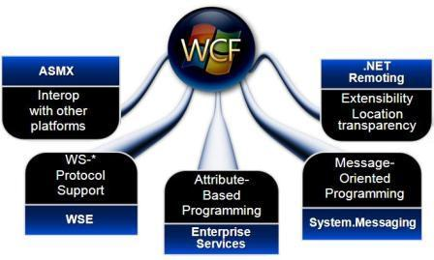
Windows Communication Foundation (WCF)
Svetlin Nakov
Telerik Corporation
www.telerik.com

Slide 2

Table of Contents
WCF – Quick Introduction
Creating a WCF Service
Creating a Service Contract
Implementing the Service Contract
Configuring the Service
Hosting WCF Services (Self-Hosting and in IIS)
Consuming WCF Services Through Proxies
Generating Proxies with the svcutil.exe
Adding Service Reference in Visual Studio

Slide 3


Table of Contents (2)
The WCF Test Client (WcfTestClient.exe)
Asynchronous Calls to WCF Services
WCF RESTful Services

Slide 4
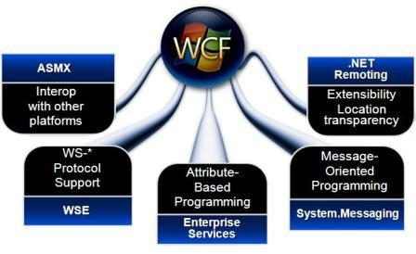
Windows Communication Foundation (WCF)
Quick Introduction

Slide 5
Windows Communication Foundation (WCF)
Programming Model
Core Services
Web HTTP Services
Data Services
RIA Services
Workflow Services
Service Model
Data Contracts
Service Contracts
Service Behaviors
Channel Model
Data Formats
(RSS, JSON, XML,…)
Data Transports
(HTTP, TCP, MSMQ, …)
Protocols
(SOAP, HTTP, Open Data Protocol, …)

Slide 6
WCF Structure: Contracts
Service contract
Describes the service methods, parameters, and returned result
Data contract
Describe the data types used in the contract and their members
[ServiceContract]
public interface ISumator
{
[OperationContract]
int Sum(int a, int b);
}
[DataContract]
public class Person
{
[DataMember]
string Name {get; set;}
}

Slide 7
WCF Structure: Bindings and Addressing
Binding
Transport – HTTP, TCP, MSMQ, …
Channel type – one-way, duplex, request-reply
Encoding – XML, JSON, binary, MTOM
WS-* protocols – WS-Security, WS-Addressing, WS-ReliableMessaging, WS-Transaction, …
Addressing
http://someURI
net.tcp://someOtherURI
net.msmq://stillAnotherURI

Slide 8
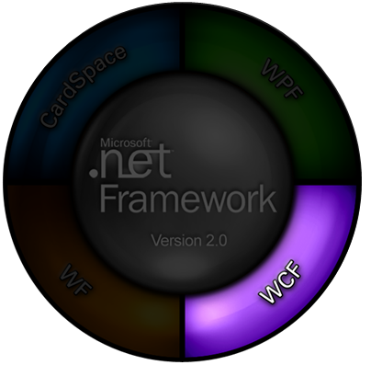
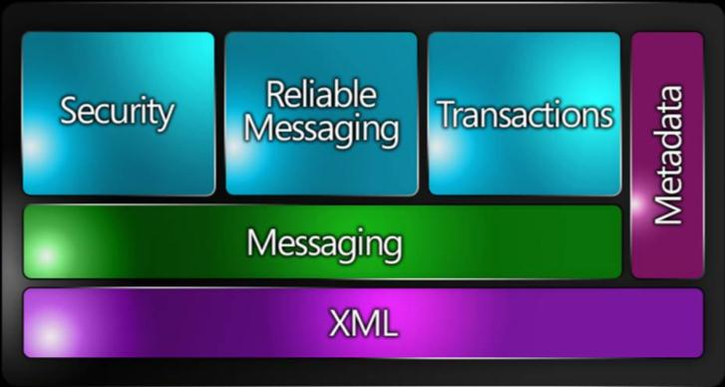
Creating a WCF Service
Step by Step

Slide 9
Using WCF: Creating and Consuming Services
WCF is а powerful Microsoft technology stack for the SOA world
Three steps to use WCF:
Create a WCF Service
Service contract, data contract, implementation
Host the WCF Service
Several hosting options: IIS, standalone, …
Consume (use, invoke) the WCF service from a client application

Slide 10
Creating a WCF Service
To create a WCF Web Service use one of the following VS templates:
WCF Service Application
WCF Service Library
Three steps to create WCF services:
Define one or more interfaces describing what our service can do (operations)
Implement those interfaces in one or more classes (implementation)
Configure the service (XML configuration file)

Slide 11
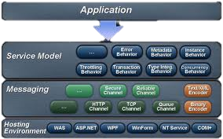
Creating a WCF Service
Step 1: Defining a Service Contract

Slide 12
Defining a Service Contract
In order for a WCF service to be used you have to define a service contract
Defines the functionality offered by the service to the outside world
Describes to potential users how they communicate with the service
The WSDL description of the service depends on the service contract
To define a contract create an interface marked with the [ServiceContract] attribute

Slide 13
Defining a Service Contract (2)
Extensive use of attributes:
ServiceContractAttribute – for the exposed service interface
OperationContractAttribute – for the contract methods that a client can see and use
DataContractAttribute – for any classes used as parameters in a method or returned as a result from a method
DataMemberAttribute – the properties of those classes visible to the clients

Slide 14
Defining a Service Contract – Example
[ServiceContract]
public interface IServiceTest
{
[OperationContract]
string GetData(int value);
[OperationContract]
CompositeType GetDataUsingDataContract(
CompositeType composite);
}
[DataContract]
public class CompositeType
{
bool boolValue = true;
string stringValue = "Hello";
…
}

Slide 15


Creating a WCF Service
Step 2: Implementing the Service Contract

Slide 16
Implementing a WCF Service
Once a contract is created, the functionality offered by the service has to be implemented
We need a class that implements the interface that defines the contract
For example:
public class ServiceTest : IServiceTest
{
public string GetData(int value)
{
return string.Format("You entered: {0}", value);
}
…
}

Slide 17

Creating a WCF Service
Step 3: Configuring the Service

Slide 18
Configuring Endpoints
WCF services are visible to the outside world through the so called endpoints
Each endpoint consists of three parts:
Address – the URL of the endpoint
Can be relative to the base address
Binding – the protocol over which the communication with the service is made
Contract – which service contract is visible through this endpoint

Slide 19
Configuring Endpoints (2)
Configure endpoints in two ways
In the application settings
By a special section <system.serviceModel> in the application configuration file
Web.config / App.config
The most frequently used approach
By C# code:
selfHost.AddServiceEndpoint(typeof(ICalculator),
new WSHttpBinding(), "CalculatorService");

Slide 20
Configuring Endpoints in Config Files
The <system.serviceModel> contains many configuration options
Two very important elements:
<services> – defines services and endpoints
<service> elements are configured by their behaviorConfiguration attribute
Points to an existing behavior
They have endpoint elements
The endpoints are configured through attributes

Slide 21
Configuring Endpoints in Config Files – Example
<system.serviceModel>
<services>
<service name="WcfServiceTest.ServiceTest"
behaviorConfiguration=
"WcfServiceTest.ServiceTestBehavior">
<endpoint address="" binding="wsHttpBinding"
contract="WcfServiceTest.IServiceTest">
<identity>
<dns value="localhost"/>
</identity>
</endpoint>
<endpoint address="mex" binding="mexHttpBinding" contract="IMetadataExchange"/>
</service>
</services>

Slide 22
Configuring Services in Config Files
The serviceBehaviors section defines behaviors (configurations) for services
Services are configured by specifying which behavior they use
Many sub-elements
serviceMetadata – metadata options
serviceDebug – debug options
dataContractSerializer – controls the way data contracts are serialized
…

Slide 23

Configuring Services in Config Files – Example
<serviceBehaviors>
<behavior
name="WcfServiceTest.ServiceTestBehavior">
<serviceMetadata httpGetEnabled="true"/>
<serviceDebug
includeExceptionDetailInFaults="false"/>
</behavior>
</serviceBehaviors>

Slide 24




Creating and Configuring a WCF Service
Live Demo

Slide 25





Hosting a WCF Service

Slide 26
Hosting WCF Service
The WCF model has many hosting options
Self hosting
In a console application, Windows Forms or WPF application
Mainly for development and testing
Windows Service
In IIS 5.1 (or later), 6.0 or 7.0
Used in production environment
Windows Process Activation Service (WAS)

Slide 27
Hosting a WCF Service in IIS
Hosting WCF services in IIS is a typical scenario
IIS itself handles creation and initialization of the ServiceHost class
We need a *.svc file to host in IIS
Base content of the .svc file:
It has the ServiceHost directive
Tells IIS in what language is the service written and the main class of the service
<%@ ServiceHost Language="C#" Debug="true"
Service="WcfServiceTest.ServiceTest" %>

Slide 28
Hosting a WCF Service in IIS (2)
The code for the service (the contract and the class implementing it) can be stationed in three places
Inline – following the ServiceHost directive
In an assembly in the Bin directory
As .cs files in the App_Code directory
You must set the necessary permissions in order for IIS to have access to your files

Slide 29



Hosting WCF Services in IIS
Live Demo

Slide 30
The ServiceHost Class
Hosting of the service is managed by the ServiceHost class
Located in System.ServiceModel namespace
You must have reference the System.ServiceModel.dll assembly
In self-hosting scenarios we initialize and start the host ourselves
ServiceHost selfHost = new ServiceHost(
typeof(CalculatorService),
new Uri("http://localhost:1234/service"));
selfHost.Open();

Slide 31



Self-Hosting a WCF Service
Live Demo

Slide 32
Using the WCF Test Client
The WCF Test Client is a GUI tool for playing with WCF services
Enables users to input test parameters, submit that input to the service, and view the response
WCF Test Client (WcfTestClient.exe) is part of Visual Studio
Can be started from the VS Command Prompt
Typical location:
Starts on [F5] in VS for WCF Service Libraries
C:\Program Files\Microsoft Visual Studio 9.0\Common7\IDE\

Slide 33
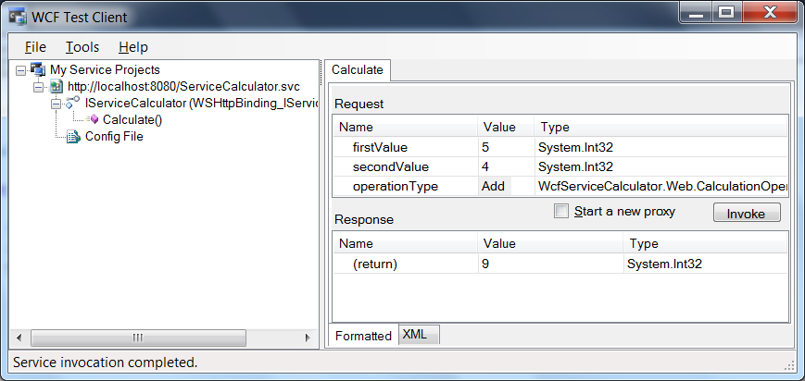
WCF Test Client
Live Demo

Slide 34

Consuming a WCF Service

Slide 35
Consuming WCF Services
To consume a WCF service we make use of the so called proxy classes
Those look like normal classes in the code
When you call a method of the proxy it makes a SOAP request to the service
When the service returns the SOAP result the proxy transforms it to a .NET type
Client
Proxy
WCF Service

Slide 36
Generating a Proxy Class
Proxy classes can be generated using the svcutil.exe tool
The simplest form (from the command line):
The service must be configured to allow getting its metadata
Via WS-Metadata-Exchange or Disco
The result is the AddService.cs class and the output.config file
svcutil http://localhost:8080/ServiceCalculator.svc

Slide 37
Generating a Proxy Class (2)
There are many options to this command line
You can set the names of the generated files
You can set the namespace
Asynchronous methods generation
The AddService.cs must be visible in our project
The contents of the output.config must be merged with the app.config / web.config
No automerging is supported

Slide 38
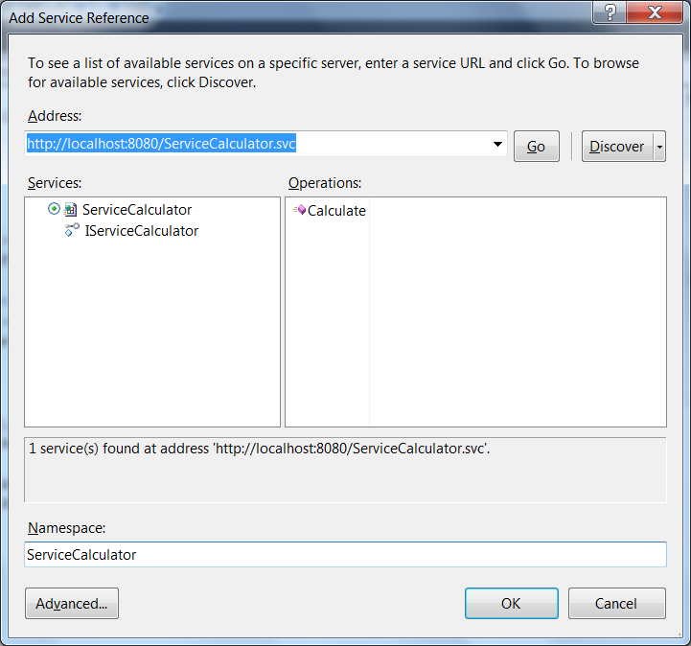
Generating a Proxy Class in VS
In Visual Studio you can also use the "Add Service Reference" option in a project
It's a wrapper around svcutil.exe
A set of XML config files is generated

Slide 39
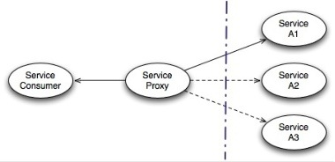
Generating a Proxy Class in VS (2)
When adding a service reference
Entries are added to the web.config or app.config respectively
Don't manipulate those entries manually unless you know what you're doing

Slide 40
Using a Proxy Class
Using proxy classes is identical to using normal classes but produces remote calls
You instantiate the proxy class
Then call its methods
Call the Close() method of the proxy
If the interface of the service changes you have to regenerate the proxy class
AddServiceClient addSevice =
new AddServiceClient();
int sum = addService.Add(5, 6);

Slide 41


Consuming a WCF Service in Visual Studio
Live Demo

Slide 42


Asynchronous Calls to a WCF Service

Slide 43
Calling a WCF Service Asynchronously
Sometimes a service call takes too long and we don't need the result immediately
We can make asynchronous calls in two ways
By using a delegate
The delegate has this functionality built-in
By generating the proxy class with the "svcutil /async" option
Creates asynchronous methods as well
When adding a service reference in Visual Studio there is an option under Advanced Settings

Slide 44
Calling a WCF Service Asynchronously (2)
When the proxy class is generated to support asynchronous calls we get few new methods
For every OperationContract method we get the BeginXXX() and EndXXX() methods
You can make use of the callback method
public void static Main() {
AsyncCallback cb = new AsyncCallback(CallFinished);
service.BeginLongProcess(params, cb, service);
}
private void CallFinished(IAsyncResult asyncResult) {
Console.WriteLine("Async call completed.");
}

Slide 45
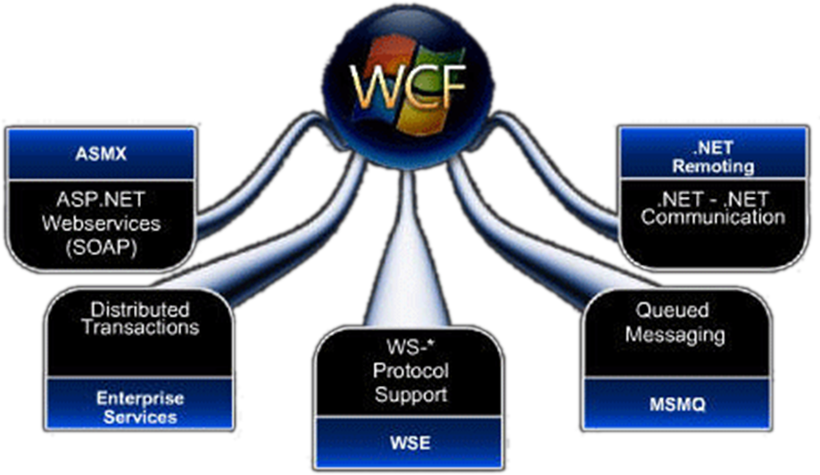
Asynchronous WCF Calls
Live Demo

Slide 46
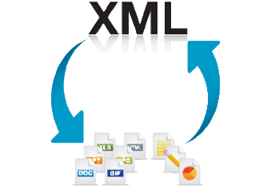

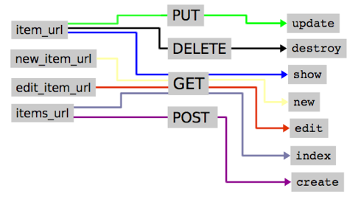
RESTful WCF Services
Creating and Consuming RESTful WCF Services

Slide 47
RESTful WCF Services
In the .svc file add the following:
Use special binding in Web.config:
Use URL mapping in the service contract
<%@ ServiceHost Language="C#" Service="…" CodeBehind="…" Factory="System.ServiceModel.Activation.WebServiceHostFactory" %>
<system.serviceModel> <standardEndpoints> <webHttpEndpoint>
<standardEndpoint defaultOutgoingResponseFormat="Json"
helpEnabled="true" />
</webHttpEndpoint> </standardEndpoints> </system.serviceModel>
[OperationContract]
[WebInvoke(Method = "GET",
UriTemplate = "Category/{categoryID}")]
Category FindCategoryByID(string categoryID);

Slide 48

RESTful WCF Services
Live Demo

Slide 49
Windows Communication Foundation (WCF)
?
?
?
?
?
Questions?
?
?
?
?
?

Slide 50
Exercises
Create a simple WCF service. It should have a method that accepts a DateTime parameter and returns the day of week (in Bulgarian) as string. Test it with the integrated WCF client.
Create a console-based client for the WCF service above. Use the "Add Service Reference" in Visual Studio.
Create a Web service library which accepts two string as parameters. It should return the number of times the second string contains the first string. Test it with the integrated WCF client.
Host the latter service in IIS.
Create a console client for the WCF service above. Use the svcutil.exe tool to generate the proxy classes.

